Slide 1
Religion in Late Modern Society: Welfare and Media
“Religion and welfare and the role of civil society in Sweden”
Uppsala University 160203,
Johan Gärde, Associate Professor

Slide 2
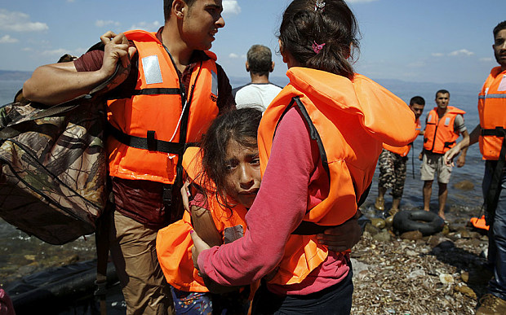
No words…

Slide 3
Mission and Vision
What is the purpose of civil society, welfare and religion?
In the “late modern society?”
Why? How? What? When?
When do we engage?

Slide 4
What is the outcome of civil society?

Slide 5
My background
Sociologist of religion, PhD, Associate Professor, Uppsala University
Faculty position at the Department of Social Sciences, Ersta Sköndal University College, Stockholm
Former Visiting Assistant Professor at the American University of Beirut and Associate Professor at Notre Dame University-Louaize, Lebanon
Areas of research: Religion, civil society and intercultural social work

Slide 6
Social worker and Sociologist of religion
Field experience: Scandinavian countries, International development & humanitarian assistance, mainly Latin America and the MENA-region (Lebanon, Syria, Iraq and beyond).

Slide 7
THE TOPIC OF TODAY
Community
Civil Society
Welfare
Religion
A Nordic and Comparative Perspective
Share some of my research findings

Slide 8
Presentation
What is your story of civil society?

Slide 9
Community
1. What is “Community?”
2. Who is defining it?

Slide 10
Text book definitions on “Community”
A social group whose members live in a specific locality, share government, and have a common heritage.
Joint possession
Similar or common character: community of interest
The public or society

Slide 11
Identity
Three kinds of identities:
Primary: Involuntary
Secondary: Compulsory
Third category: Voluntary
From: Bernard Lewis “The Multiple Identities of the Middle East”

Slide 12
Primary Identities
Primary identities are acquired at birth.
1. Blood: The family, the clan, the tribe and developing into the ethnic nation.
2. Place: Often, but not always coinciding with the first and sometimes in conflict with it. Village or neighbourhood, district or quarter, province or city, developing into the country.
3. Religious Community: Often subdivided into sects.

Slide 13
Secondary category of identity
“Allegiance to a ruler, the obedience to the sovereign; the head of state or of a department, the governor, the administrator, or the headman of a village.”
From: Bernard Lewis “The Multiple Identities of the Middle East”, 1998.

Slide 14
Third category of identity
“In modern times, under the influence of the West a new kind of identity is evolving: freely chosen cohesion and loyalty of voluntary associations:”
“Civil Society”
From: Bernard Lewis “The Multiple Identities of the Middle East”, 1998.

Slide 15
FIRST, SECOND AND THIRD SECTORS
The evolution of modern societies as national-states gives rise to institutions and organisations established for three relatively distinct sets of purpose:

Slide 16
Public Sector and Government
First Sector:
To protect and regulate the lives and actions of citizens, that is to manage how society is defended as well as how it functions and progresses.
Actor: Governments

Slide 17
Corporate Sector
Second Sector:
To ensure people have livelihoods as well as creating and accumulating wealth.
Actor: Business and Market

Slide 18
NGOs..
Third Sector:
To pursue personal or social interests, beliefs and concerns.
Actor: Voluntary Associations, NGOs

Slide 19
1. Civil Society
Welcome to the world of abbreviations!

Slide 20
GONGOs and DONGOs??..
NGOs
INGOs, NNGOs, SNGOs
GONGOs
DONGOs, MONGOs
PVAs
CSOs
CBOs
FBOs

Slide 21
1. Civil society: “the extreme” case of Sweden
Why do we have high numbers of registered associations compared to other parts of the world?
Sweden: 71 000-150 000 registered associations, 9 000 000 people
The MENA-region: Approx. 230 000 registered associations, 500 000 000 people.

Slide 22
Trust and Identity
Putnam’s theory on trust
Bonding trust
Bridging trust
Identity: Bernard Lewi’s theory on multiple cultural identites

Slide 23
CIVIL SOCIETY ACTORS
Public Sector Private Sector
Informal Social Sector Formal Social Sector

Slide 24
THE NATURE OF CIVIL SOCIETY
Religion, Culture, Ideology and Values
Material Base Organizational Expressions (social policies)

Slide 25
I. FINANCIAL BASE –
SOME STATISTICS
The Civil Society sector is a major economic and social force in the world. It has been reported that in the mid 1990s, this sector accounted for:
more than 1.3 trillion USD in expenditure,
had more than 39.5 million employees.
This represents 5.1% of the combined gross domestic product of the 35 countries studied by Johns Hopkins.
The world’s seventh largest economy.
190 million people volunteering, or 221 volunteers per 1,000 adult population.
Source: Salamon et als 2003, Global Civil Society at-a-glance,
Johns Hopkins University.

Slide 26
Cont.
The revenues funding the NGO sector come from the public sector, private donations and through fees & charges.
Employment in nonprofit organizations has a tendency to grow much faster that overall employment in both developing and developed countries. In some countries, this growth is more than three times faster.

Slide 27
FINANCIAL BASE - REVENUES
Fee-dominant countries: Majority of countries in Latin America.
Public sector-dominant countries: Scandinavia, Germany, Netherlands, Austria, UK.
Philanthropy-dominant countries: Central and Eastern Europe, Israel and the US.

Slide 28
II. ORGANIZATIONAL EXPRESSIONS
Private Voluntary Associations (PVAs)
Non Governmental Organisations (NGOs)
Community Based Organisations (CBOs)
Civil Society Organisations (CSOs)
Religious congregations (FBOs)
Hybrid organisations

Slide 29
CATEGORIZATION OF CIVIL SOCIETY ORGANIZATIONS (CSOs)
CSOs are:
Recreational, in such fields as sports, arts and crafts, nature and the environment etc.,
Market/related, that is industrial associations, employers’ associations, labor unions, consumer groups etc.,
Ideological, that is to say organizations set up by people sharing religious, philosophical or political views;
Community based, e.g. organizations of people living in the same area or members of the same ethnic group or gender.

Slide 30
FIELDS OF NONPROFIT ACTIVITY
1. Culture
2. Education and research
3. Health
4. Social services
5. Environment
6. Development
7. Civic and advocacy
8. Philanthropy
9. International
10. Religious congregations
11. Business and professionals, unions
12. Other
(Source: Salamon 2003)

Slide 31
III. RELIGION, CULTURAL, IDEOLOGY AND VALUES
Today’s conceptualisations about civil society, originating in the 18th, 19th and early 20th century, are rooted in competing interpretations of how Northern societies matured to form and function as national states.
Current thinking has yet to integrate learning from the emerging experiences of the South and East.
Today's views are temporally partial and our knowledge incomplete.
(Fowler, p.13-14, From Clayton 1996)

Slide 32
Maps are being re-drawn: organisational expressions are culture at work..
How does my world look like?
In the private sphere
How does our world look like?
In the social and public sphere?
How about the/our systems and legal frameworks? Structural dimensions
“Jag kör mitt eget race”
“Jag måste stå upp för min religion”

Slide 33
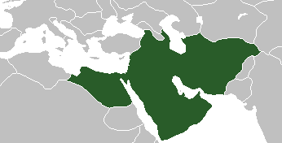
What’s the name of this country? Have you been there?
Caliphate 2.0?

Slide 34
Adaption emotional patterns in time of crisis and turmoil
I cope
I embrace
I hate
I love
I evolve
Regression as a mechanism of defense

Slide 35
Contextual background of Sweden a) Migration and culture b) religion c) welfare

Slide 36
a) Multicultural Sweden, the short version, citizens born in foreign countries
Finland
?
Poland

Slide 37
Nr 2
Iraq

Slide 38
(2012) Födelseland
 | Totalt
Finland | 163 867
Irak | 127 860
Polen | 75 323
Jugoslavien | 69 269
Iran | 65 649
Bosnien‑ Hercegovina | 56 595
Tyskland | 48 731
Turkiet | 45 085
Danmark | 44 209
Somalia | 43 966
Norge | 42 884
Thailand | 35 554
Chile | 28 425
Syrien | 27 510
Kina | 26 824
Totalt | 1 473 256

Slide 39
b) Religious heritage
Hundreds of years of paganism or Asa-tro: ”den forna/hedniska seden" (hinn forni/heiðinn siðr” until approx. 1000-1100.

Slide 40
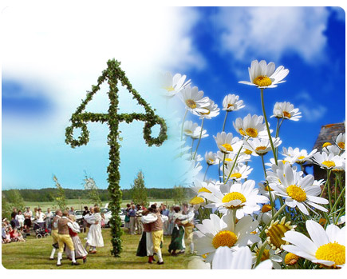
Swedish Midsummer Feast, June 21

Slide 41
Second historical phase
2. 5-600 years of Catholicism, until 1500 ca

Slide 42
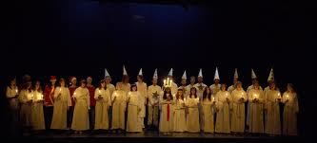
Lucia-feast, December 13

Slide 43
Cont.
3. 400 years of State Lutheran Protestantism, until 2000
4. 150 years of Protestant Free Churches, still on-going but decreasing in numbers and members.

Slide 44
Cont.
5. 50 years of increasing numbers of others congregrations/religions such as Catholicism, Orthodoxism, Oriental churches and Islam (increasing), mainly due to immigration.

Slide 45
Typ av congregation | Church attendance | Members
Church of Sweden | Decreasing | Decreasing
Evangelical free churches (liberal) | Decreasing | Decreasing
Pentecostal churches | Stable | Increasing
Roman-Catholic Church | Stable | Increasing
Oriental Catholic churches | Increasing | Increasing
Orthodox churches | Decreasing | Stable
Oriental churches | Increasing | Increasing
Other denomination, movements and sects | Varying | Varying
Islam | Increasing | Increasing

Slide 46
c) The Swedish Welfare Model

Slide 47
Country | Welfare system
Northern Europe
Sweden | Social Democratic
Norway | Social Democratic
Finland | Social Democratic
England | Liberal
Continental Europe
Germany | Conservative and corporatist
France | Corporatist
Italy | Conservative/corporatist or Social/capitalist
Greece | Southern European
Eastern Europe
Latvia | Liberal and conservative-corporatist
Poland | Conservative and corporative
Croatia | Post-communist, not classified
Romania | Post-communist, not classified
Welfare Systems in Europe, some examples using Esping Andersen model: it’s a confusing world!

Slide 48
What is typical in the Swedish Welfare Model?
The Strong Emphasis of the role of the State in the Regulation, Funding and Implementation of Welfare
General Welfare Policies and Services
Strong Central Government in Social Policy Making – strong Local Government in Implementation

Slide 49
Cont.
Focus on Citizens’ equality
Tax- and not fee-based: voucher system
A generalised right-based and not
ad-hoc need-based approach
Resource-allocation is legitime and politically correct (strong government ok)

Slide 50
Sources
Johns Hopkins University
Civicus
Intrac

